Slide 1
Final Presentation
Attend-In
Team members: Duc Pham
Md Rifat Uddin
Jalen Davis
Jason Tran

Slide 2
Overview of today’s presentation
Recap on purpose of our project
The functional and non-functional requirements
A demonstration of the web app’s functionalities
A walk-through of our source code
Project goals and achievements
Team experience

Slide 3
What is Attend-in
A web application allows students to take attendance with their Laptops
BUT only if they are within proximity of their classroom
Support real-time interaction
Allow professors to download attendance information to their devices

Slide 4
What is Attend-in for?
Streamline the attendance taking process by allowing students to digitally submit their attendance so less class time is wasted
Gives professors organized digital records of attendance for easy storage
Ensures students’ honesty by requesting students’ current device location

Slide 5
Requirements
Functional Requirements
● Users can specify which specific class they are taking attendance for
● System allows users to see the status of each seat in real time (available, considering, blocked)
● Users are required share their location
● System updates seats in response to user selection
● The Primary Database must validate student information
Non Functional Requirements
● Database must be able to store all attendance records of one semester (roughly 8 million records)
● Server must be able to handle 52,000 concurrent users (total number of students in GSU)
● System is required to accurately locate student
● System must update seat status within 3 milliseconds
● Landing page must load within 3 seconds
Notes:
1st bullet its a number of weeks in a semester multiplied by 52, 000 students within 10 sessions (52,000*10*14 = 8 million)

Slide 6
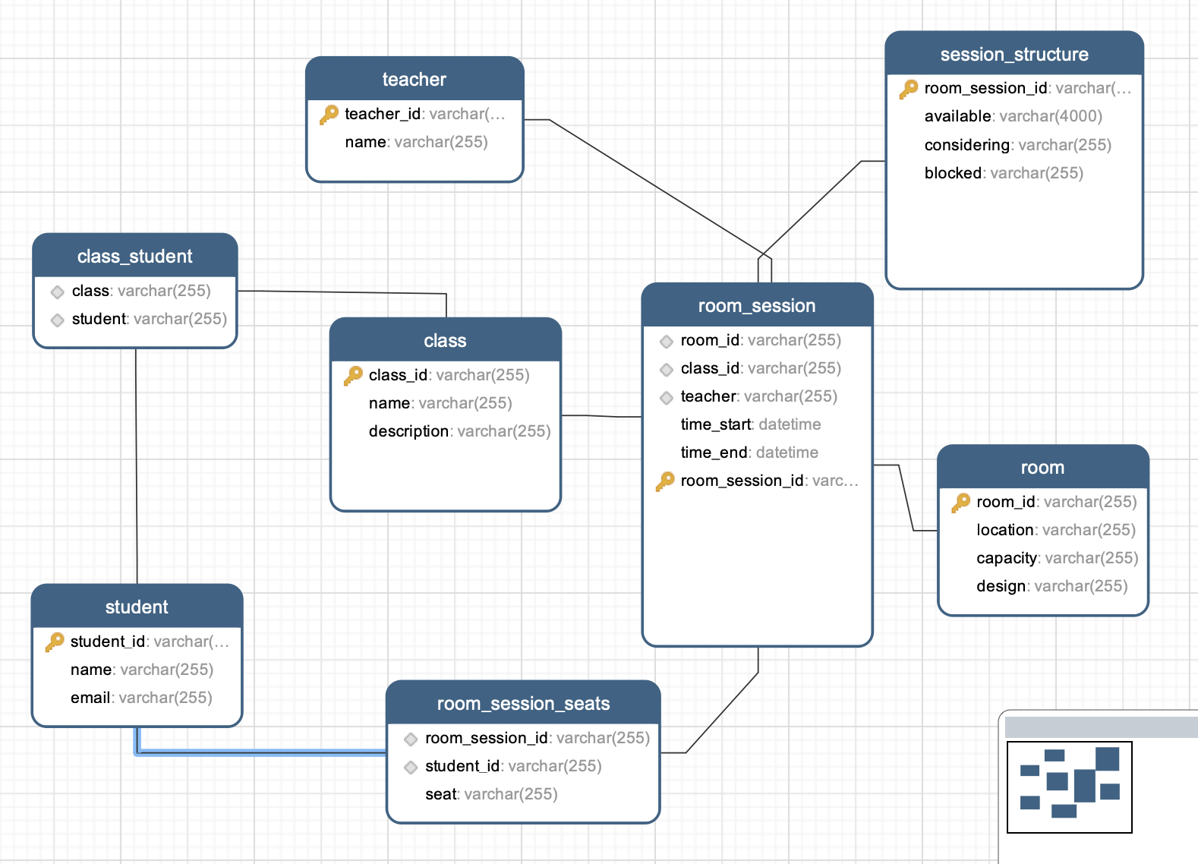
Demonstration - Database Design

Slide 7
Demonstration - Functionalities
1 - Welcome Page Demo
2- Code + Explain for step 1
3- Seat Selection Page with multiple users Demo
4- Explain for step 3
5- Student validate Demo on Postman

Slide 8
Overview
Future Implementation:
Add redis caching (currently mutual exclusion is being used)
Ability to generate and download attendance sheet (for professors)
Add room designs of GSU classrooms into database
What we achieved
Implemented a working real-time seat-map
Learned how to properly utilize mySQL server in an application
React.js and Python FastAPI
Development tools: Postman, RedisInsight, Navicat
Team Experience
Overall we enjoyed most aspects of our project
Our team efficiently communicated and collaborated every step of the project

